Slide 1
Power BI Desktop
In this power point presentation explained that how to pull data from data source and cleaning process of data by using power BI desktop with the help of screenshots

Slide 2
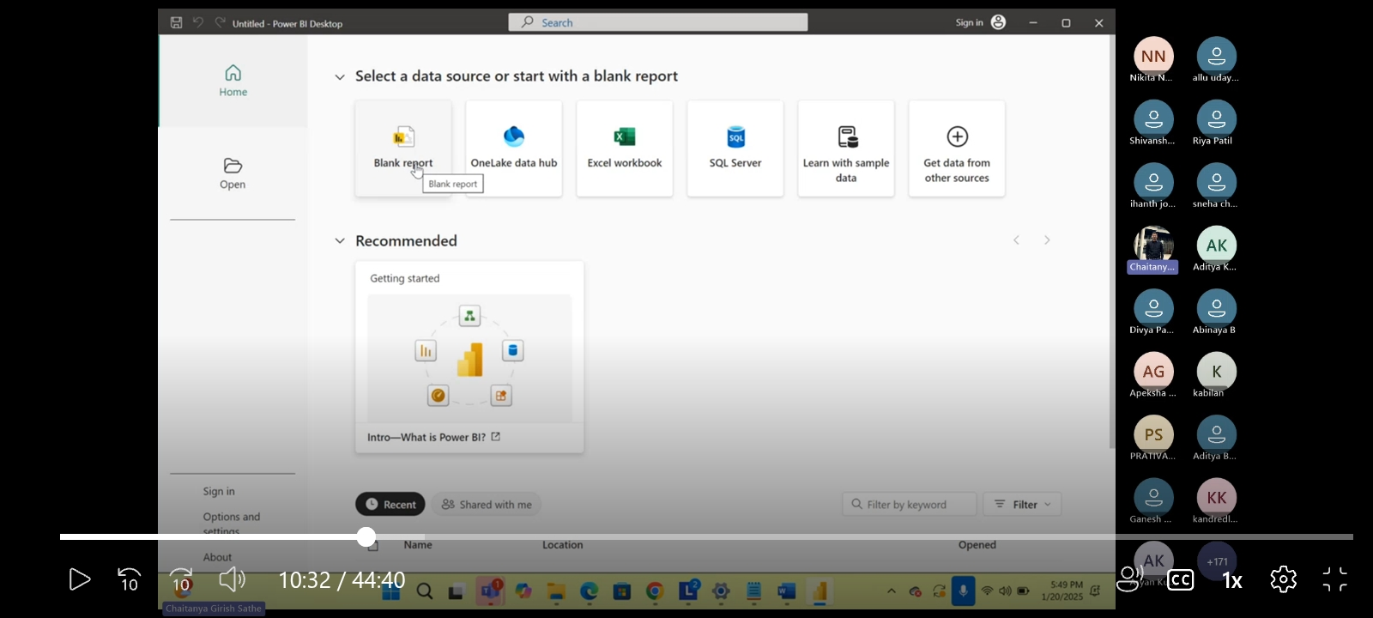
When we open power BI desktop then this type of interference will open . Now click on Blank report.

Slide 3
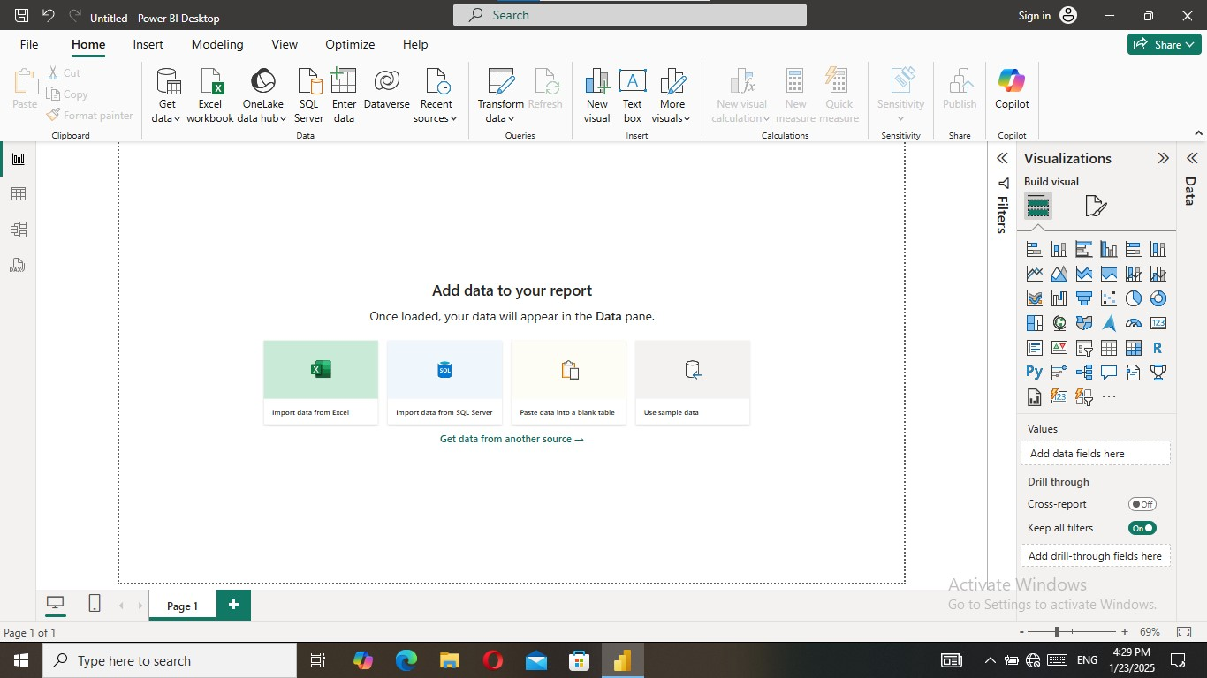
After click on blank report this window is appeared. This window is called as power BI desktop.

Slide 4
In this slide power bi desktop tools name is given with arrows
All view
Filter
Canvas

Slide 5
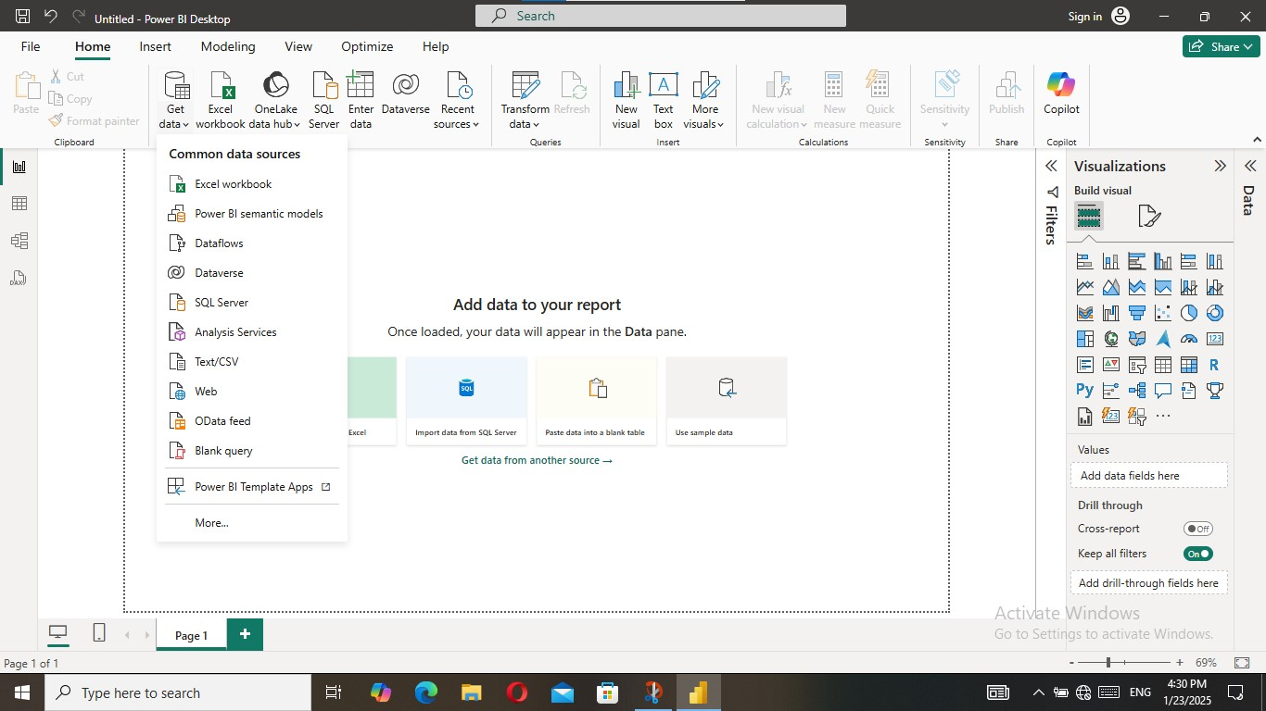
Now we want to extract data from data source so click on Get Data then multiple data source will appear. It is shown in screenshot with red colour.
Multiple data source

Slide 6
Our file is CSV file so we will click on Text/CSV

Slide 7
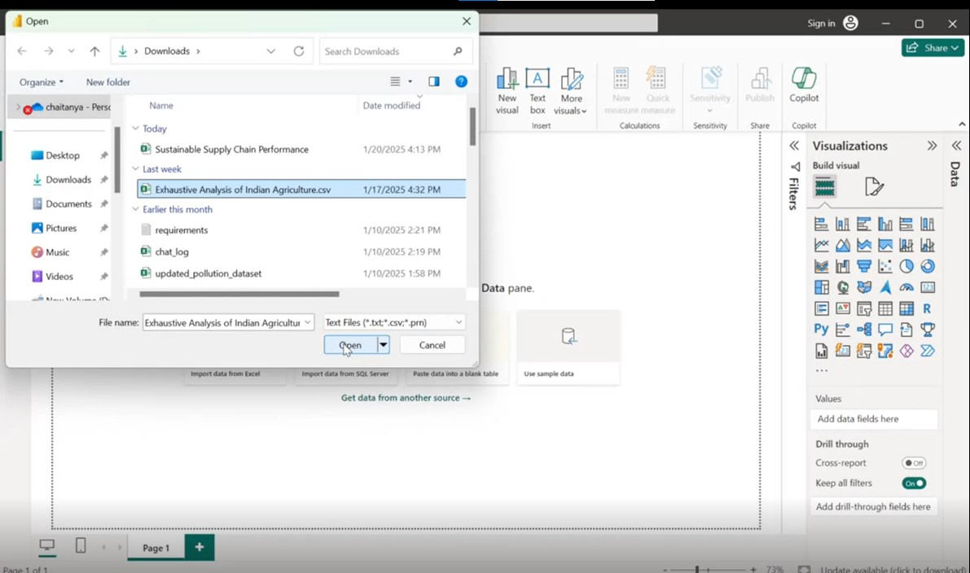
Then a window will open select the file and click on open as below given in screenshot

Slide 8
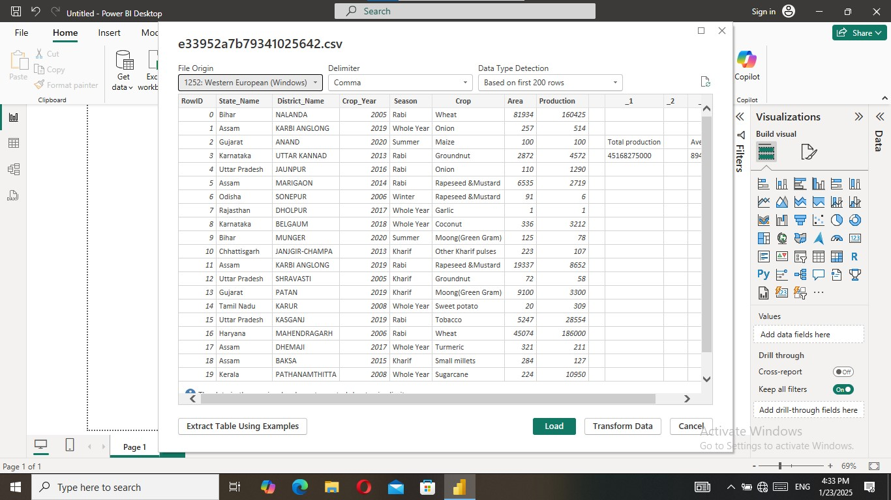
Now a window will open and there is three button Load, transfer and cancel. This window is overview of data. Now click on load button

Slide 9
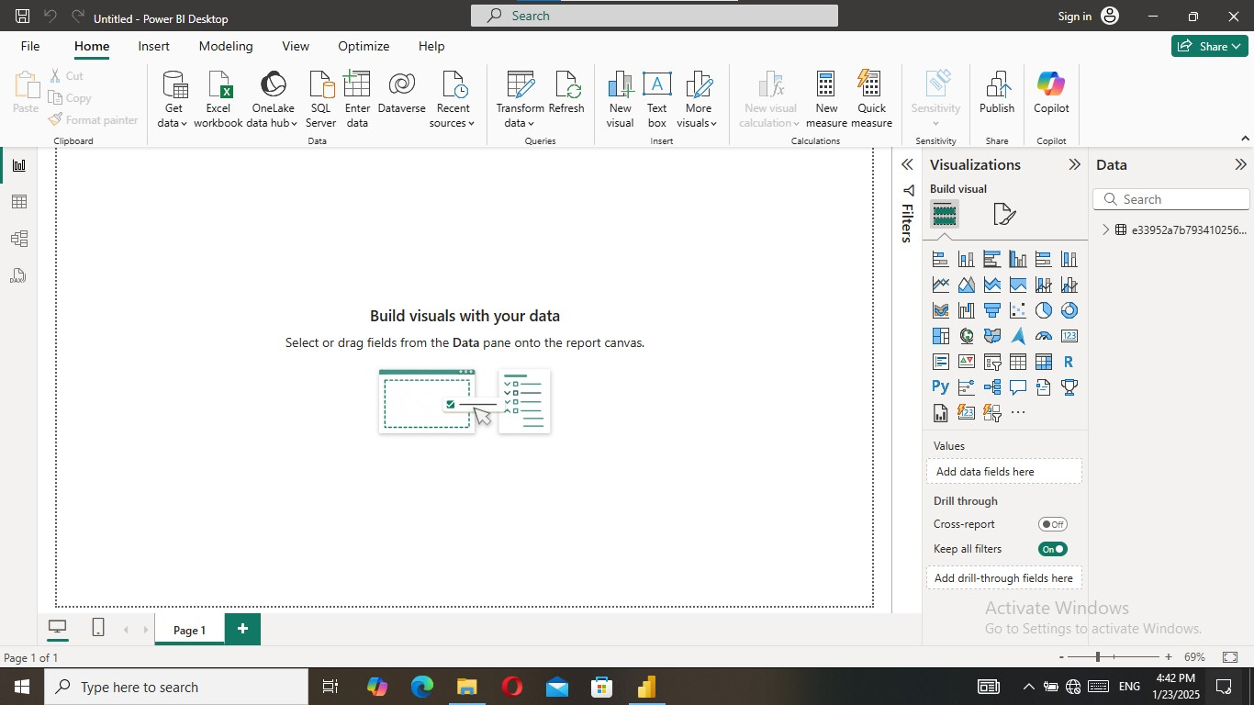
Now data file is appeared on right side. All the view is described for their use
Report view- for all visualization
Table View –overview of data
Model view – joining data each other

Slide 10
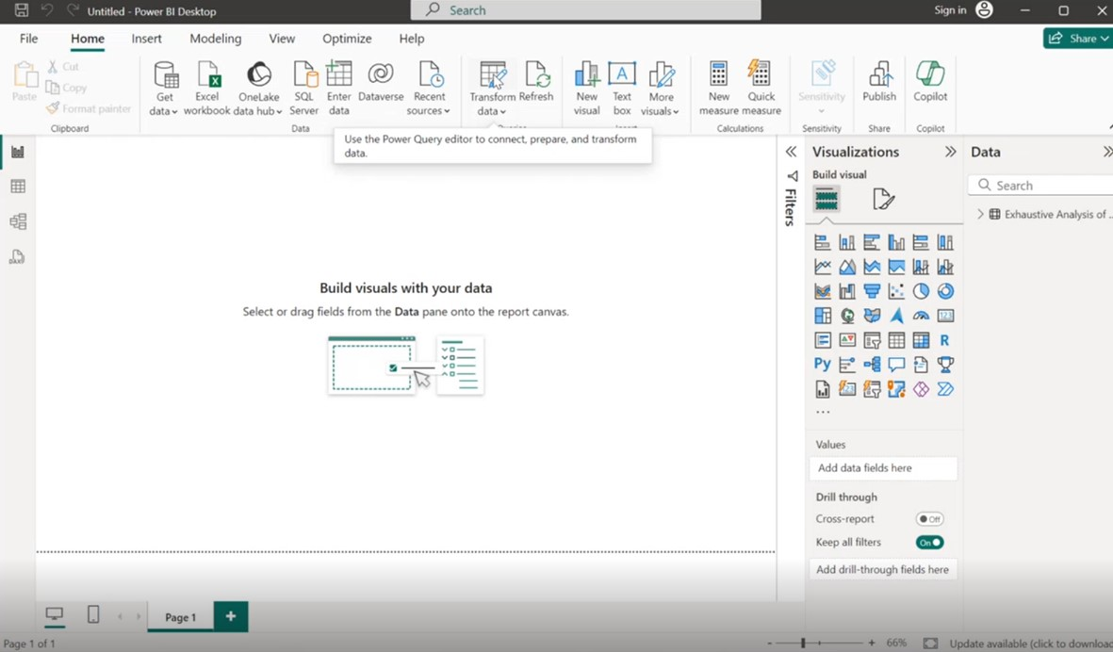
When data is not cleaned click on transform data

Slide 11
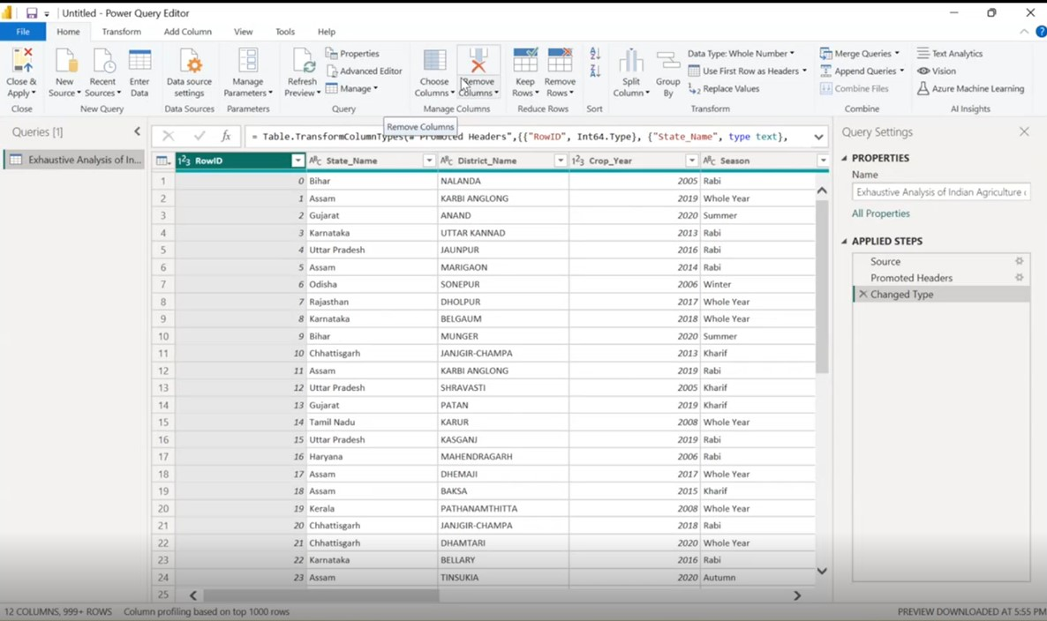
After click on transform data new window will open this is heart of any analysis. This is called as power query editor. We do all transformation using this window

Slide 12
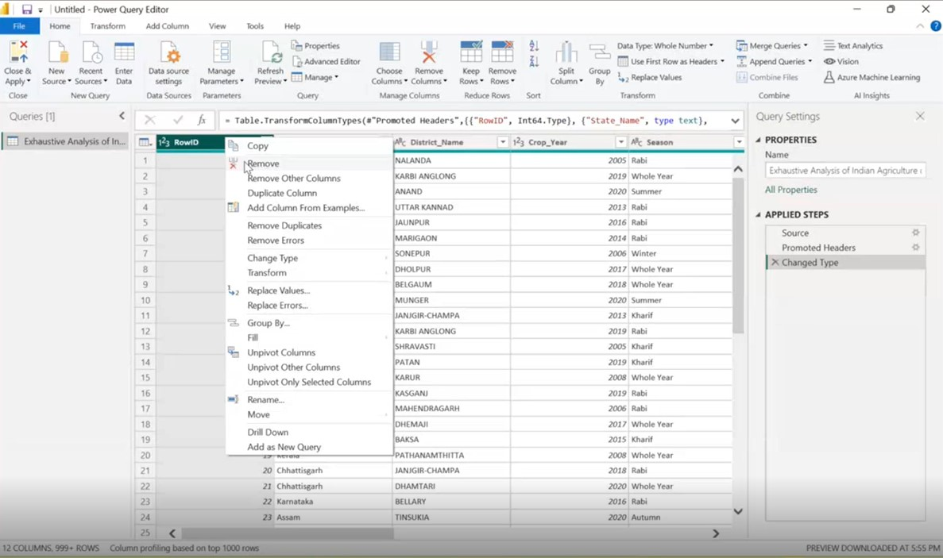
Now we remove all blank column and not useful column. Now for remove the RowID column click right click on it and then click on remove button.

Slide 13
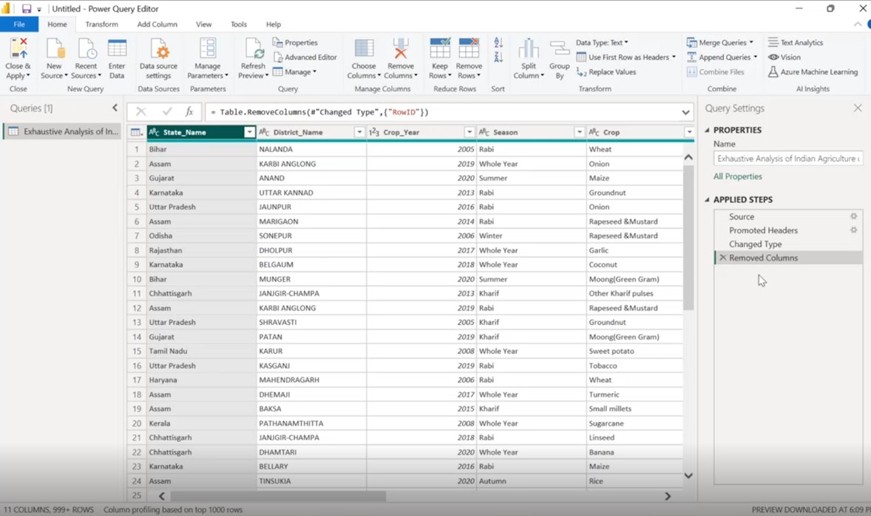
After click on remove button whole column is removed as shown in screenshot of this slide. If we mistakenly removed the column then click on cross botton to reappear it.

Slide 14
After removing of unuseful columns we will check the empty rows and error in rows so click on the view tab.

Slide 15
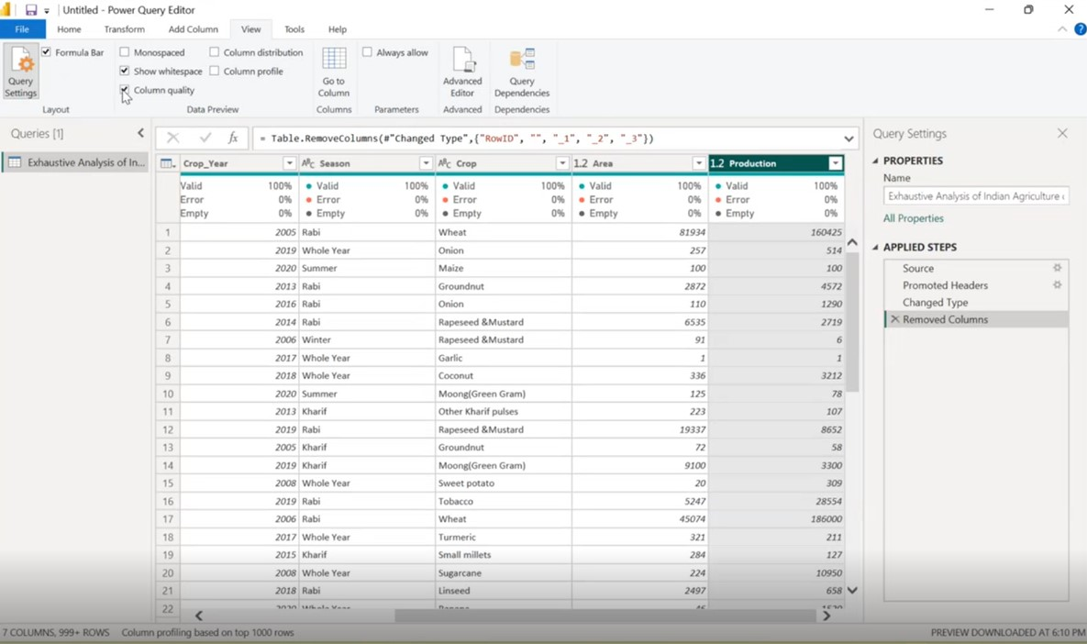
After click on view tab then click on column quality box then small box will open on every column top part. In this small box we can see error and empty.

Slide 16
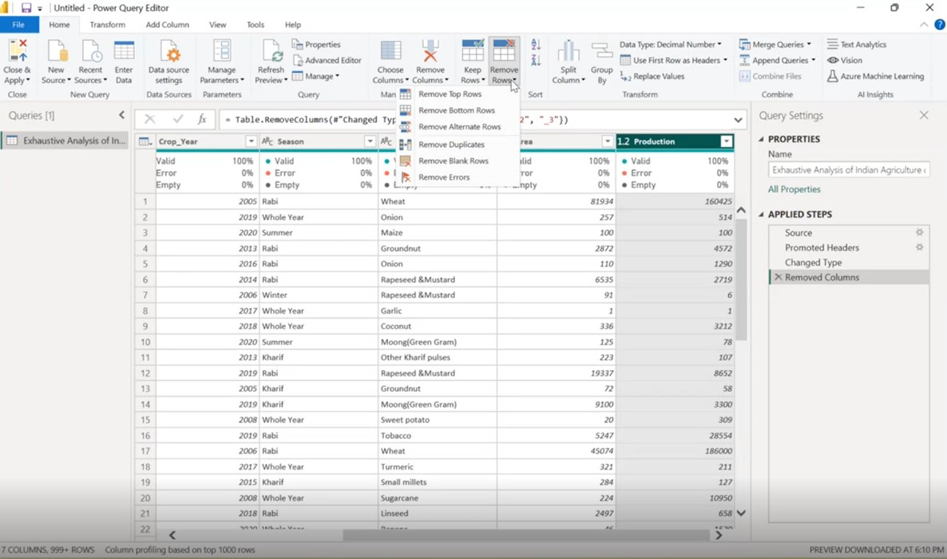
We can remove rows and duplicate rows by click on Remove rows .

Slide 17
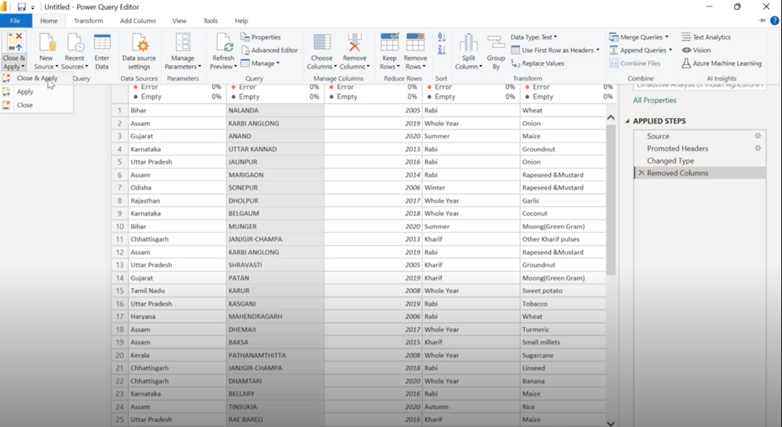
After checking all errors and transforming process we will reflect it on power bi desktop so click on close & apply button .

Slide 18
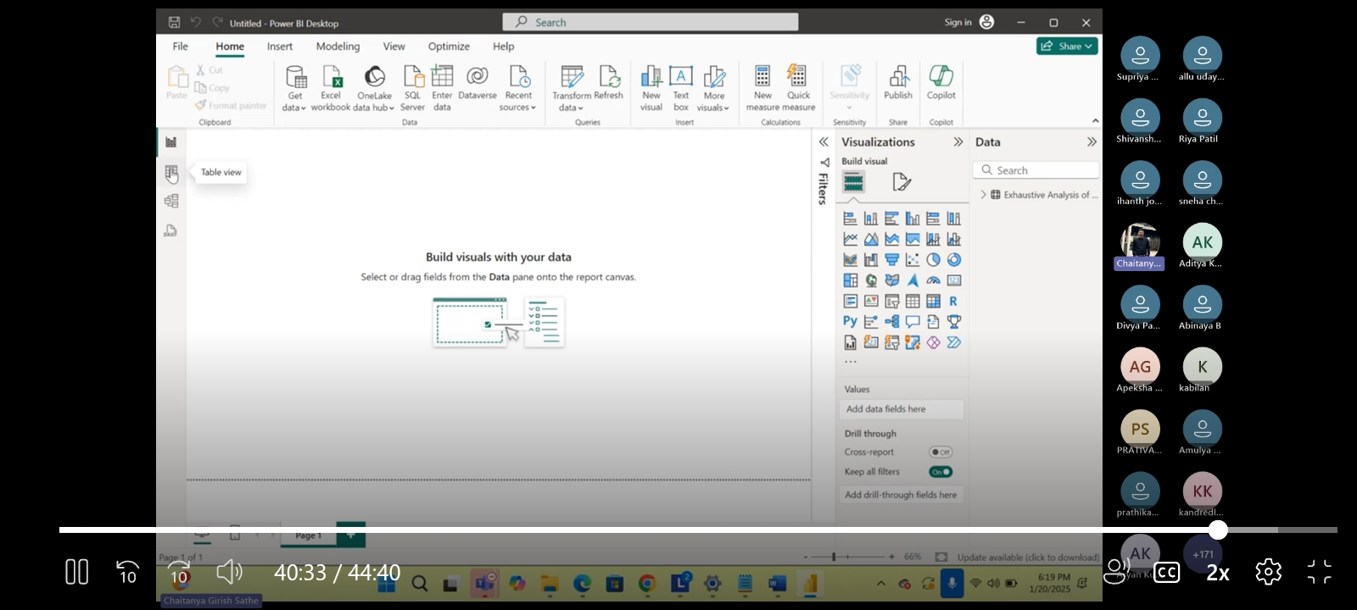
Now our file is uploaded on power bi desktop . Now for overview of data we click on table view.

Slide 19
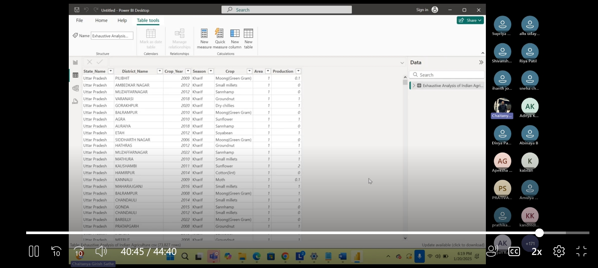
Now our data is loaded in table view.

